Slide 1
Mobile Application Development
Application Resources

Slide 2
Application Resources
Resources are the additional files and static content that are used by an application .
Types of Resources:
  Color state list resource
  Drawable resources
  Layout resource
  String resources
  Menu Resource
  Etc

Slide 3
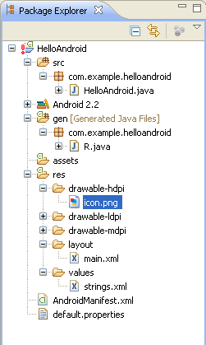
Android Directories and files
All source code here
Java code for our activity
All non-code
resources
Generated Java code
Helps link resources to
Java code
Images
Layout of the activity
Strings used in the
program
Android Manifest

Slide 4
String Resources
A string resources provides text strings for the application with optional text styling and formatting.
They are saved in res/values/ folder and accessed from the R.string, R.array, and R.plurals classes.

Slide 5
String Resources
string is an XML resource that provides a single string that is referenced using a value provided in the name attribute (not the name of the XML file).
String resources can be combined with other simple resources in the one XML file, under one <resources> element.
A single string that can be referenced from the application or from other resource files (such as an XML layout).

Slide 6
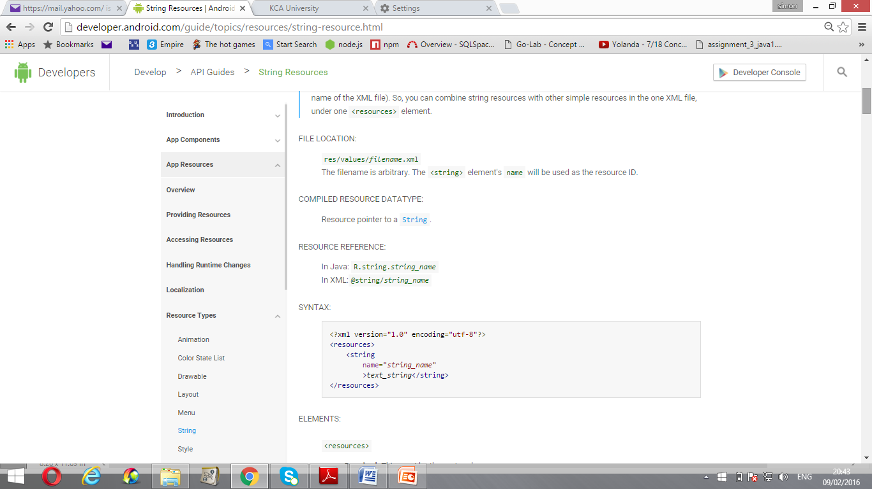
String elements and attributes
<resources> element is the root node of string.xml file
<string>: element that specify the data type string
name: attribute storing string ID.
Syntax:

Slide 7
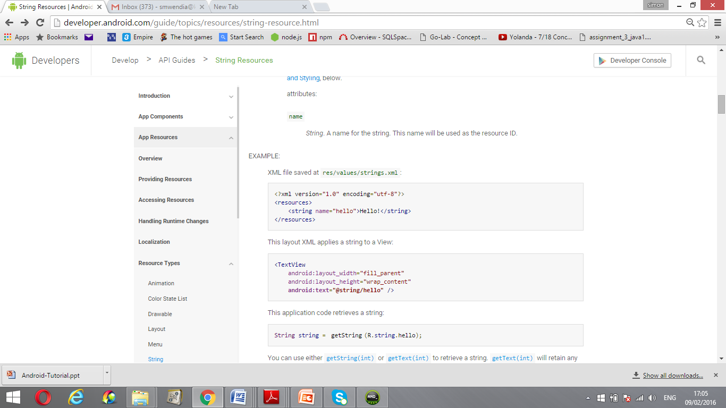
Creating a string resource
XML file saved at res/values/strings.xml
Example of a string file

Slide 8
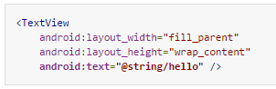
Application of String Resource
The following TextView applies a string to an attribute text

Slide 9
Color Resource
This is a resource that is used for defining color values.
It is created in res/values/ folder
Color resource can be used in any place that accepts a hexadecimal color value.

Slide 10
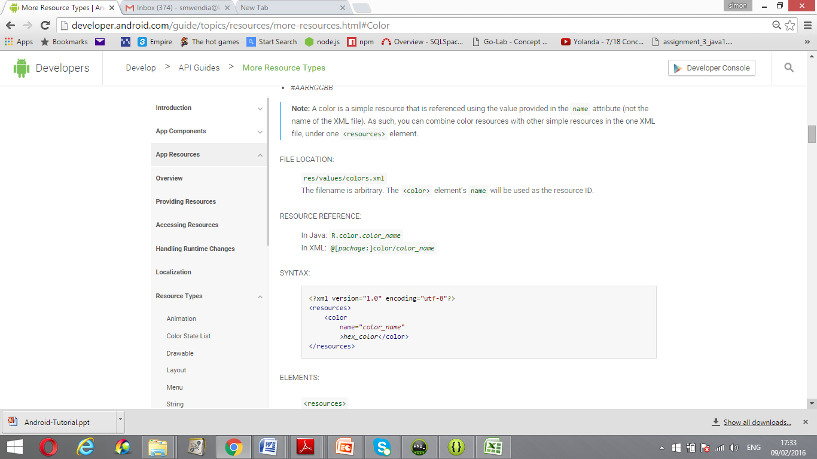
Color Resources
Syntax
<resources> This must be the root node with no attributes.
<color> element defines data type of the attribute
Name: attribute is used for storing color ID.

Slide 11
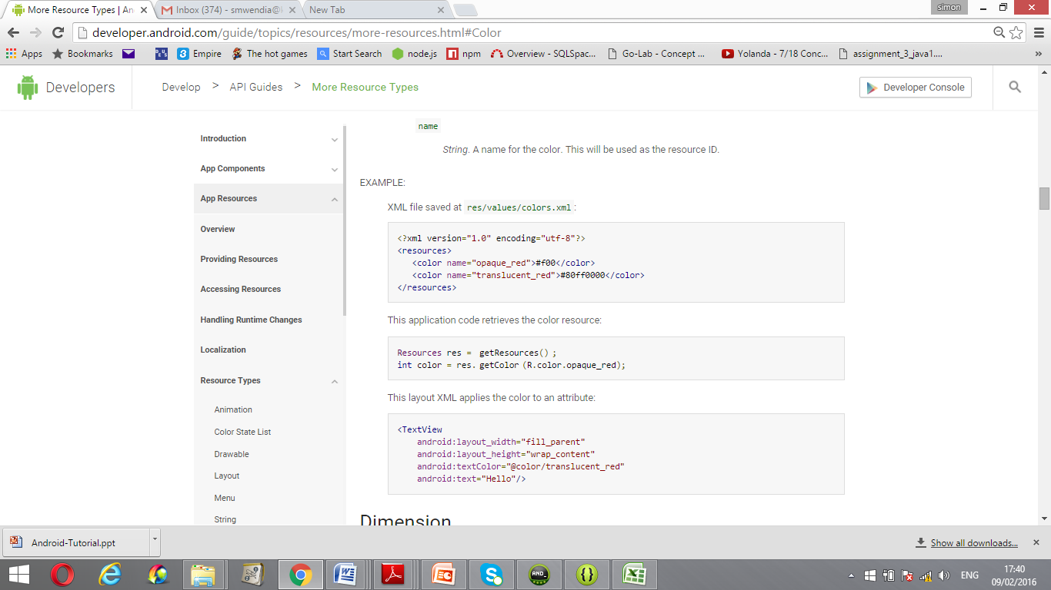
Creating a color resource
Color resource file is saved in res/values/colors.xml
Example:

Slide 12
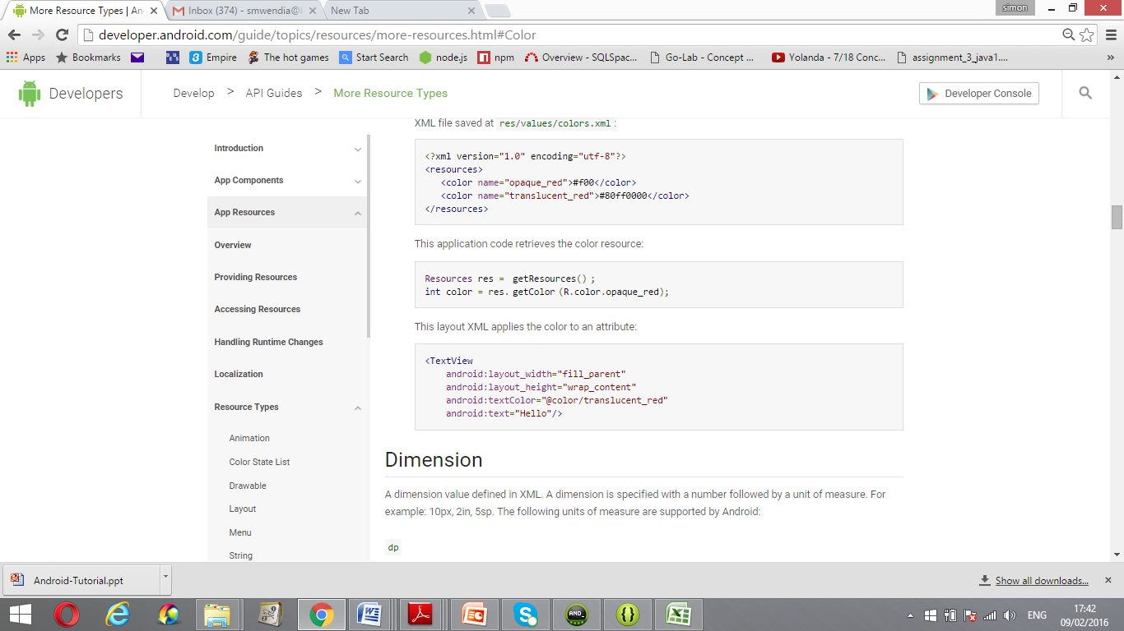
Application of color resource
The following TextView applies the color to textColor attribute

Slide 13
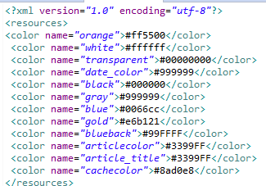
Exercise:
Create a color resource file known as mycolors.xml and save it in values/ folder

Slide 14
Exercise:
Use the color elements defined in mycolors.xml file to
change the background color of at least one xml file in
layout folder.
For example, changing the background color of home.xml
file to blue

Slide 15

